Slide 1
Leapfrog at 15
Leah Binder, President & CEO, The Leapfrog Group

Slide 2






The Leapfrog Group
Founded by purchasers in 2000 in response to 1999 IOM Report To Err is Human
Purchaser-driven nonprofit publicly reporting on hospital quality and safety
Works at the regional level through regional rollouts and as well as the national level

Slide 3
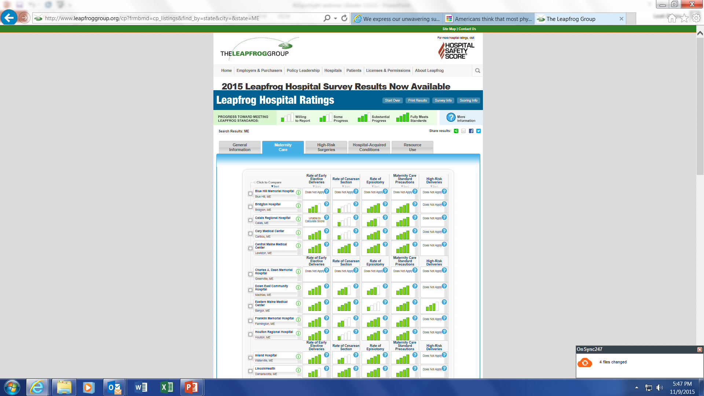
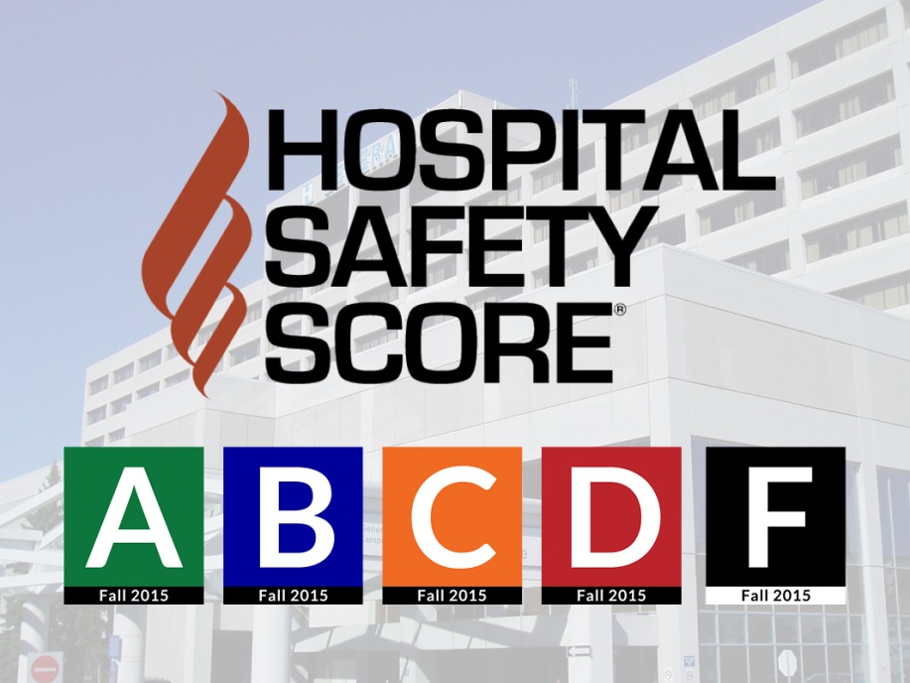
Two Main Initiatives
Launched 2001
Launched 2012

Slide 4
1664: All Time Record
Notes:
2015 was an all-time record year for Survey participation, with over 1600 surveys submitted.

Slide 5
Using Leapfrog
Purchasers
Hospitals
Pay for value programs
Contract negotiations
Benefits design strategies
Employee engagement
Meet demands for value
National benchmarking
Quality improvement, including reaching for highly competitive performance (ie Baldridge journey)
Gold standard for demonstrating transparency
Direct relationships with employers/purchasers

Slide 6
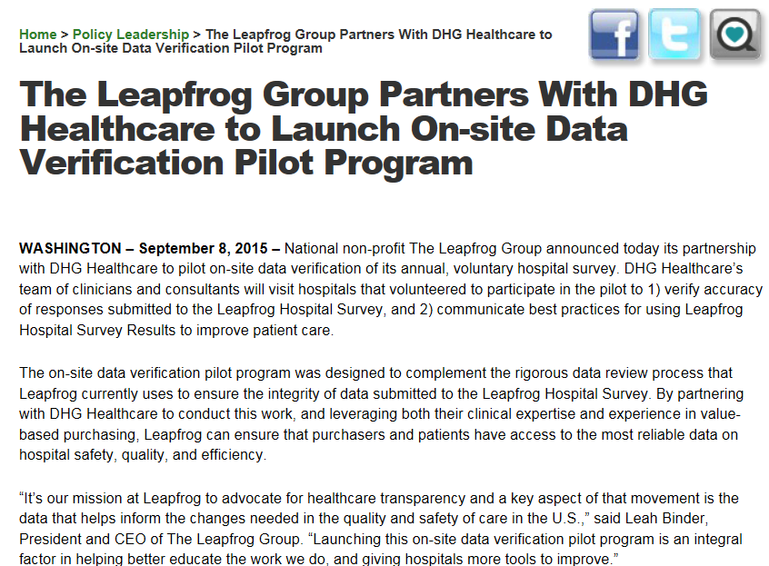

Slide 7
Goals of the Verification
Verify on site at hospitals the reliability of data reported to the Leapfrog Hospital Survey
    Expands validity beyond current intensive desk review process.
Support innovations in quality improvement

Slide 8
Key Questions Answered in Pilot Verification
Are the survey responses accurate and does the verification promote greater accuracy? | YES
Can we reliably verify survey responses using a shorter half-day, on-site verification protocol? | YES
Can we ease the administrative burden for hospitals by providing a binder to aid in collection of documentation and preparation for the verification? | YES
Do hospitals perceive value in the on-site verification process? | YES
Should we move forward with an expanded on-site verification program to randomly select even more hospitals next year? | YES

Slide 9
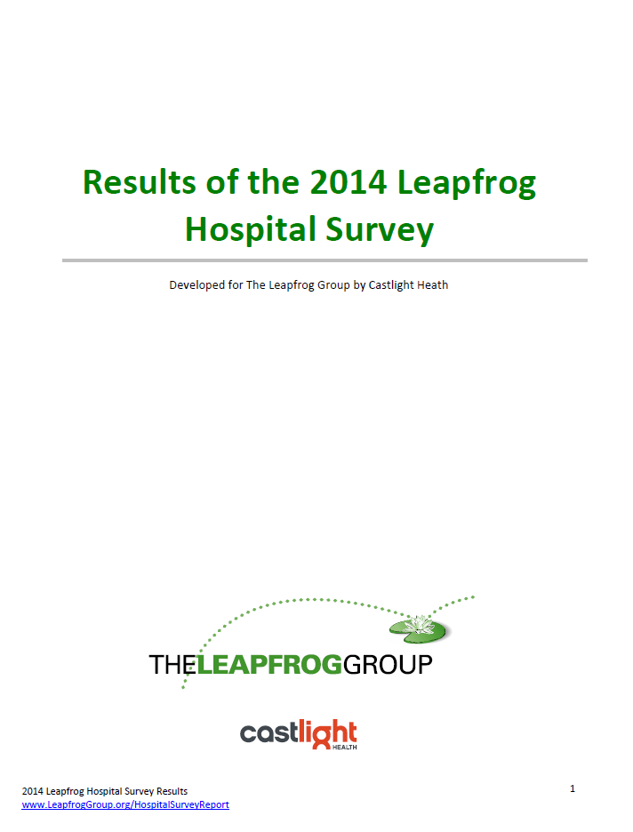
Notes:
Leapfrog also partnered with Castlight Health to issue monthly reports on the results of the Leapfrog Hospital Survey, highlighting one result a month including maternity care, hand hygiene, nursing, and other topics important to purchasers and consumers. These reports attract considerable media attention.

Slide 10
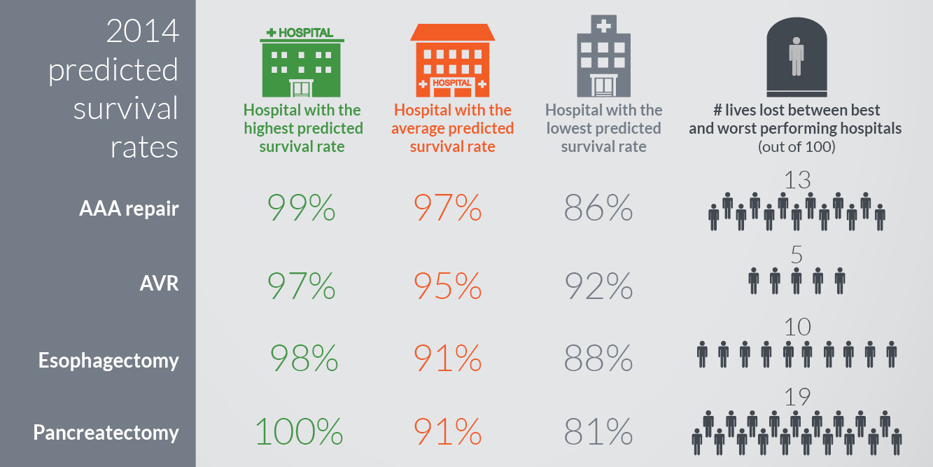
High-risk Surgeries
Notes:
Here’s an example from the Castlight report on high-risk surgeries, where Castlight notes the number of lives lost out of 100 surgeries between best and worst performing hospitals.

Slide 11
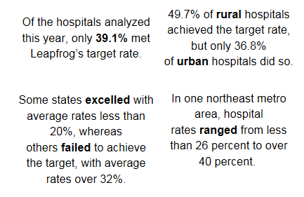
Cesearean Sections: 2015 Leapfrog Hospital Survey Analysis

Slide 12

Hospital Safety Score: Consumers
Notes:
Leapfrog launched the Hospital Safety Score in 2012, issuing a letter grade rating the safety of all general hospitals in the country regardless of whether they report to the Survey. We update the scores every six months. A dream team of the foremost researchers in patient safety serve on the Expert Panel advising the Board on how to weigh publicly available safety measures and calculate the hospital’s scores. One of the most gratifying results: hospitals are taking their safety score to heart and rallying to improve. One hospital system ties CEO compensation in part to the hospital’s score. HCA health system (160+ hospitals) has a standard interview question for all CEO candidates: what’s your Hospital Safety Score? Piedmont Health System CEO launched a huge campaign: A by May. Only one of their hospitals failed to achieve the goal last Spring. The Fall 2015 Hospital Safety Scores came out at the end of October, and Leapfrog got more press for this announcement than nearly any other round of releases, including front page stories in dozens of media markets.

Slide 13
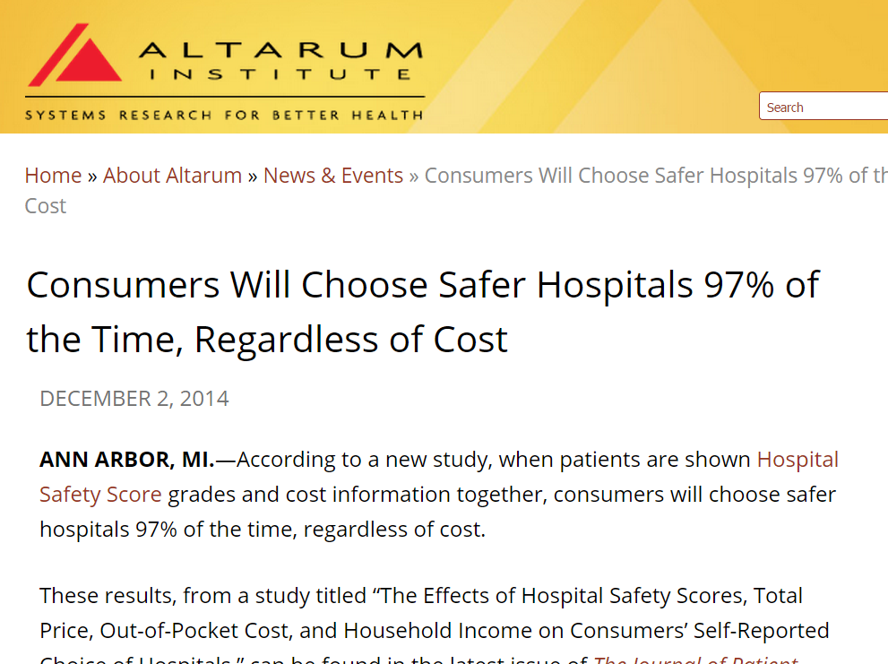
Important to Consumers
Notes:
The Altarum Institute tested the Hospital Safety Score alongside pricing data with over 2500 consumers and found that the letter grade on safety trumped the pricing virtually every time.

Slide 14

High Deductible Health Plans
Percentage of Covered Workers Enrolled in Either a HDHP/HRA or HSA-Qualified HDHP, 2006-2014
* Estimate is statistically different from estimate for the previous year shown (p<.05).
SOURCE: Kaiser/HRET Survey of Employer-Sponsored Health Benefits, 2006-2014.

Slide 15
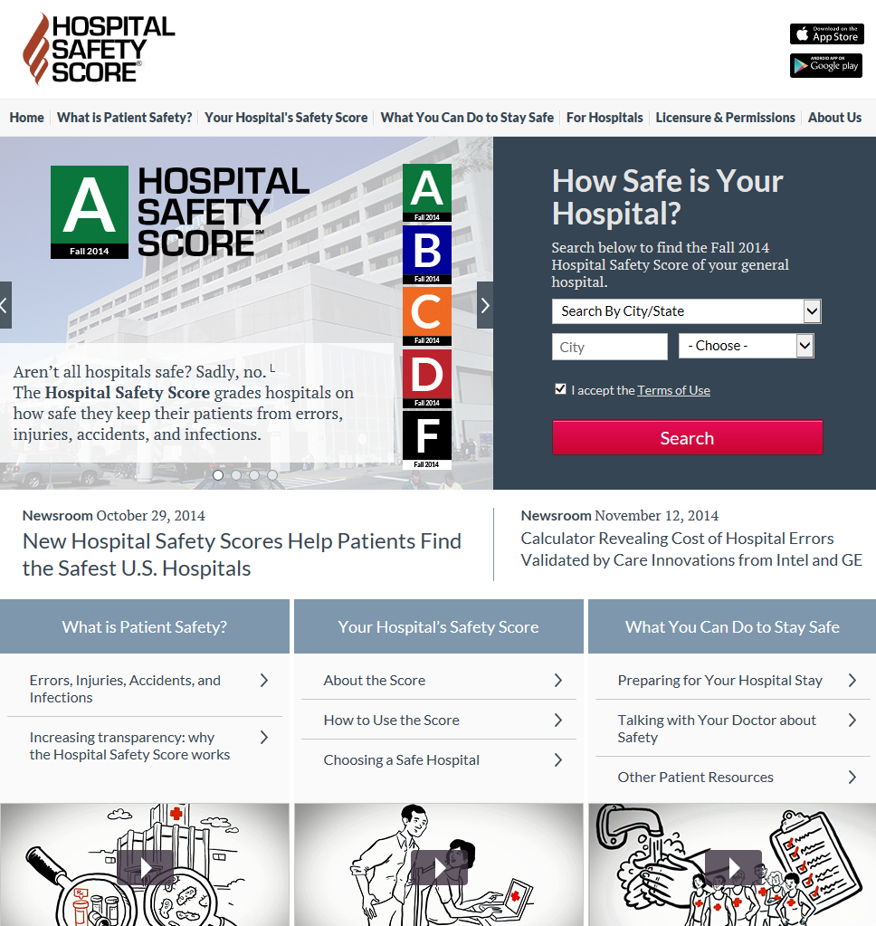
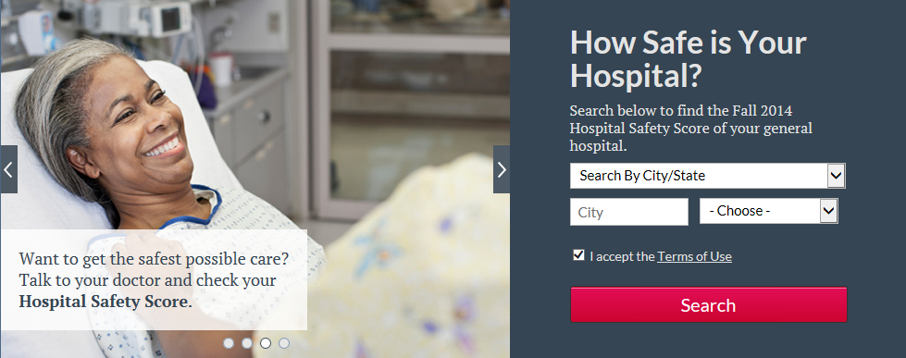
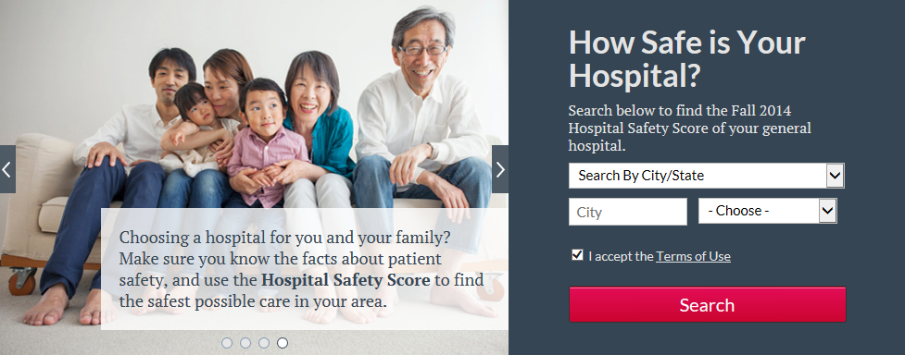
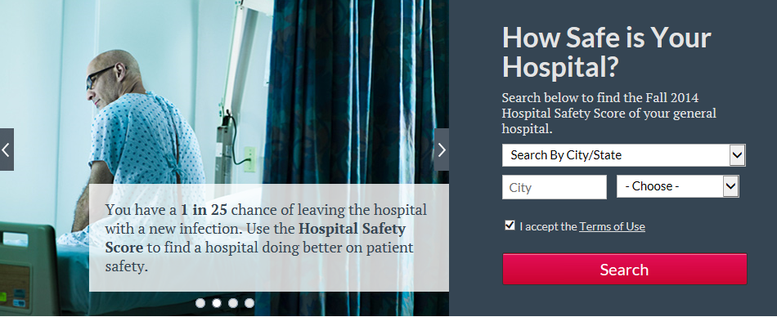
www.hospitalsafetyscore.org
Notes:
We are glad hospitals are engaged, but Leapfrog’s primary goal in launching the Score was to reach out to consumers. With a grant from Robert Wood Johnson Foundation, Leapfrog worked with Shoshanna Sofaer and health literacy experts to redesign the Hospital Safety Score website to be accessible to consumers of varied literacy levels. Here’s a screen shot that shows how the language was designed and tested to give consumers a fuller understanding of what we mean about safety and the Score, and how they can protect themselves.

Slide 16
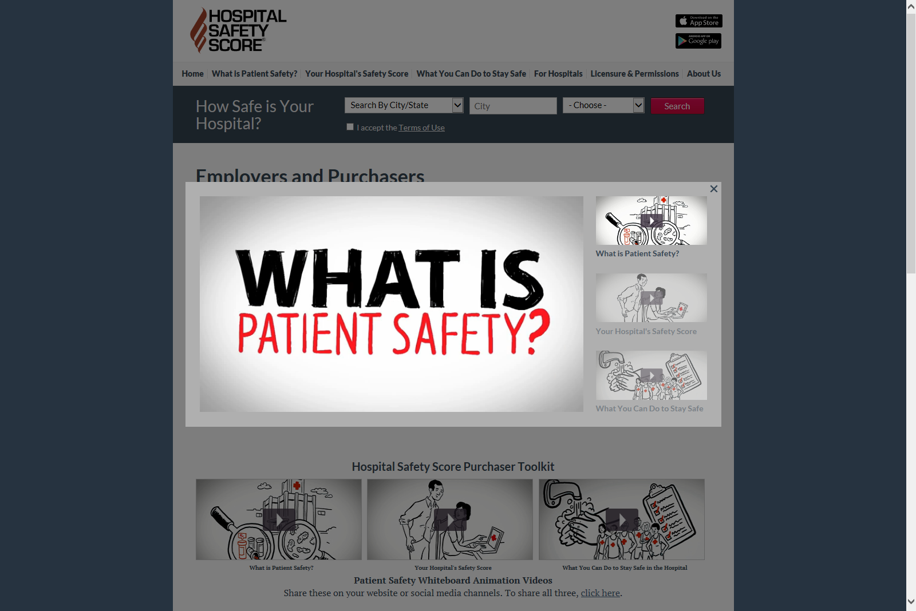
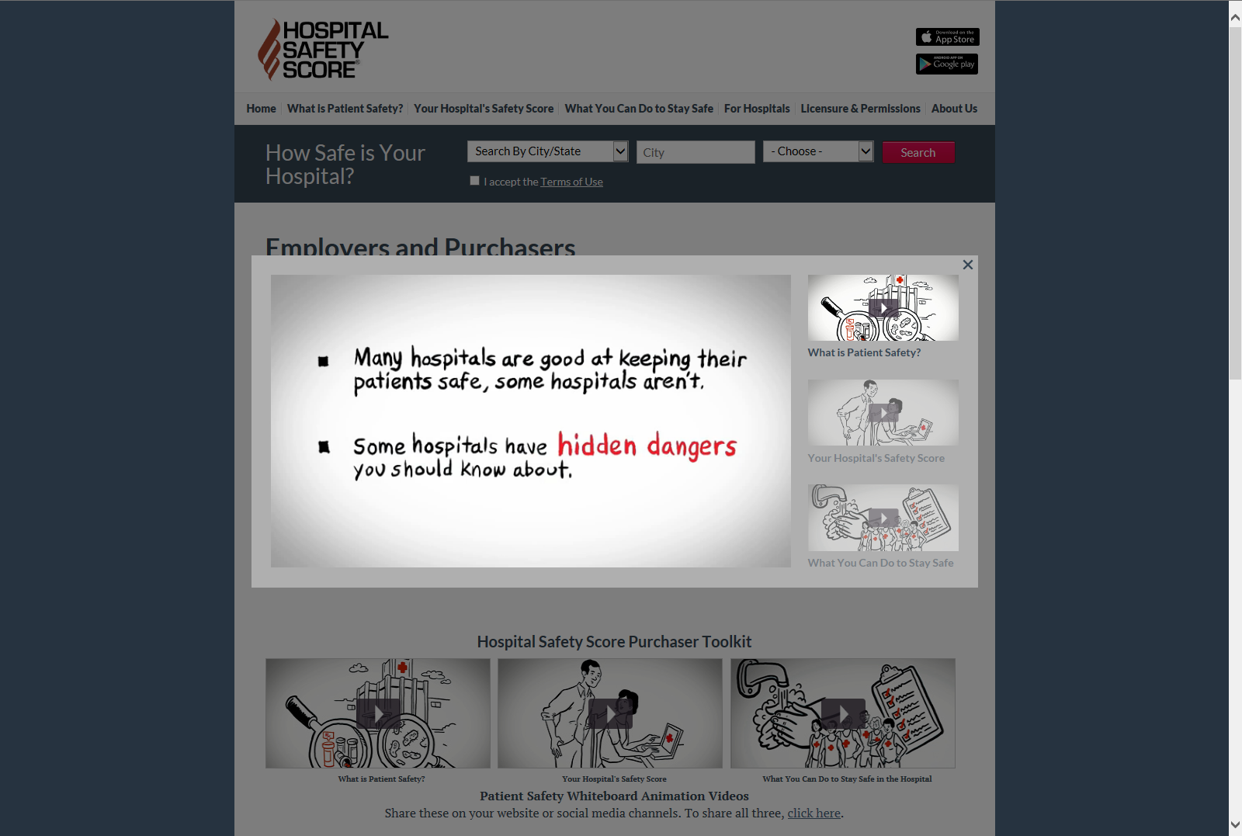
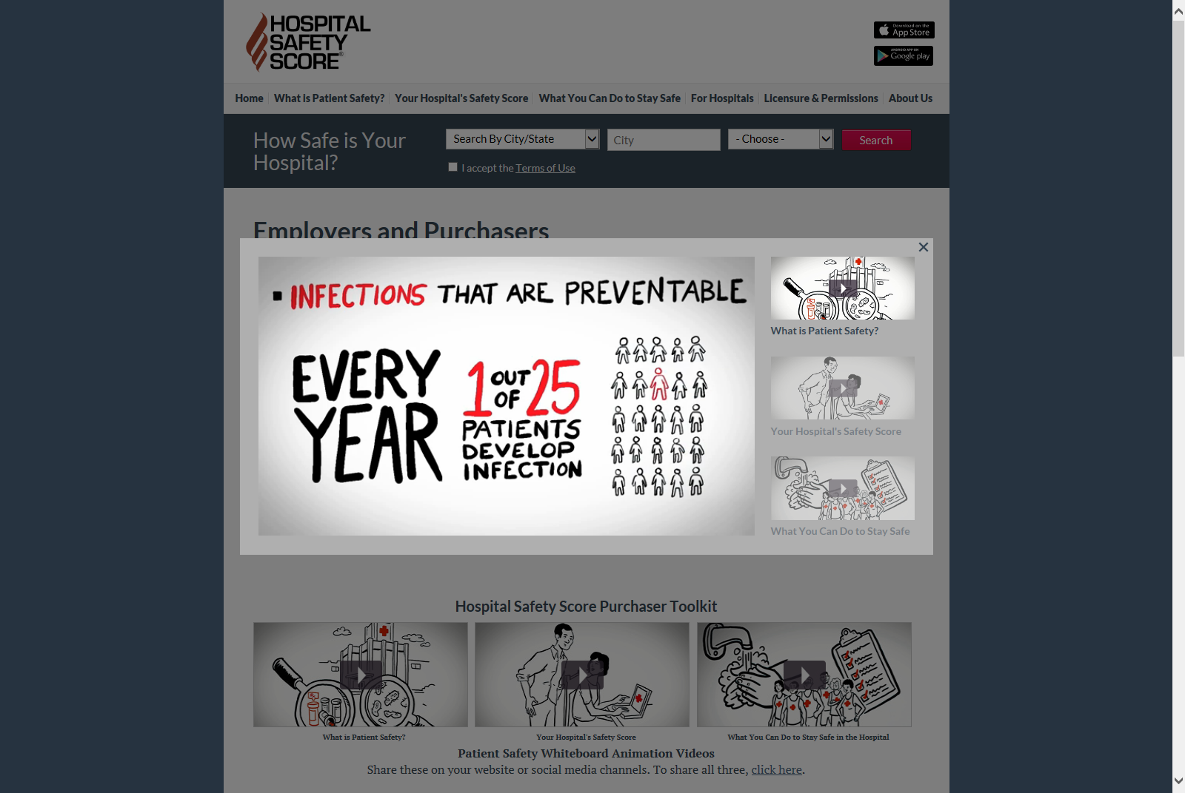
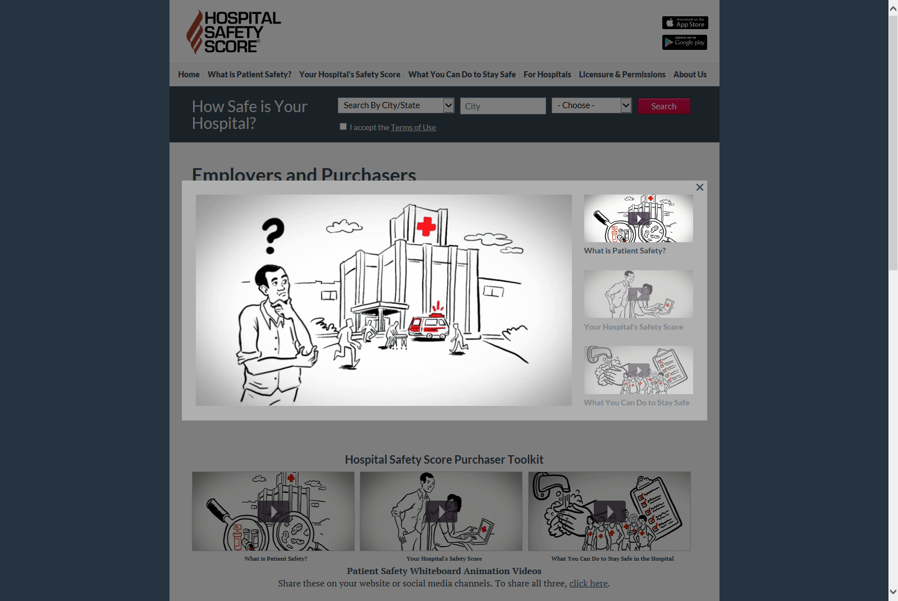
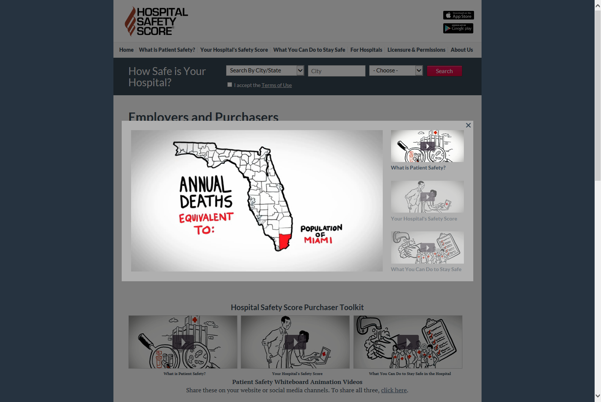
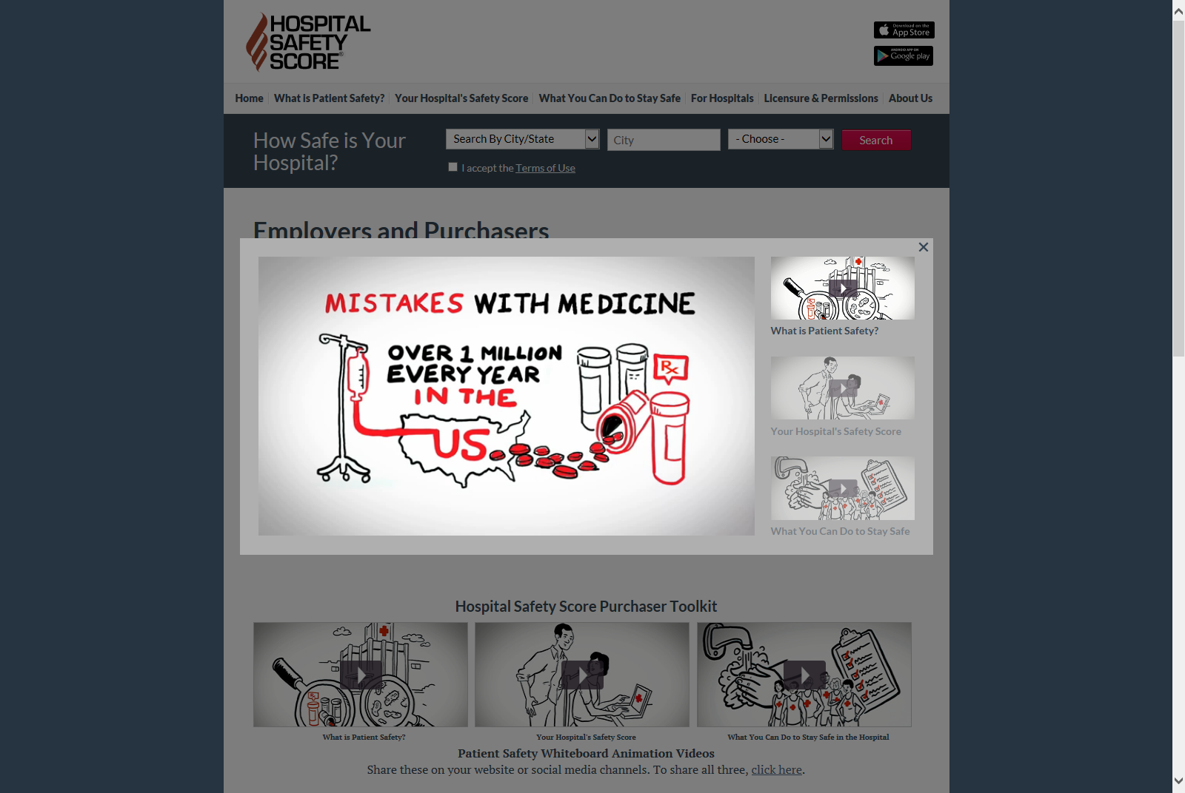
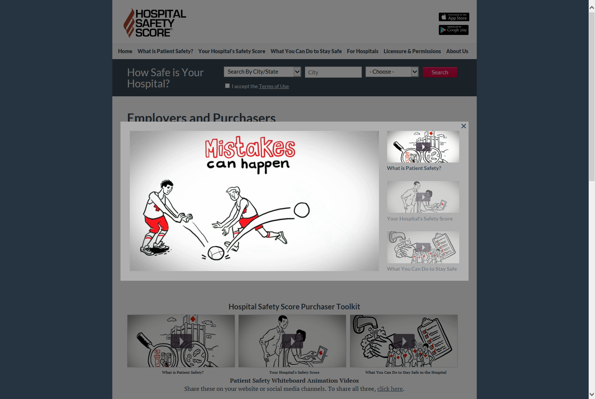

Notes:
The site has white board videos on what patient safety is, your hospital’s score, and what you can do to be safe—and any of you are welcome to download the whiteboard videos and use them on your own site.

Slide 17
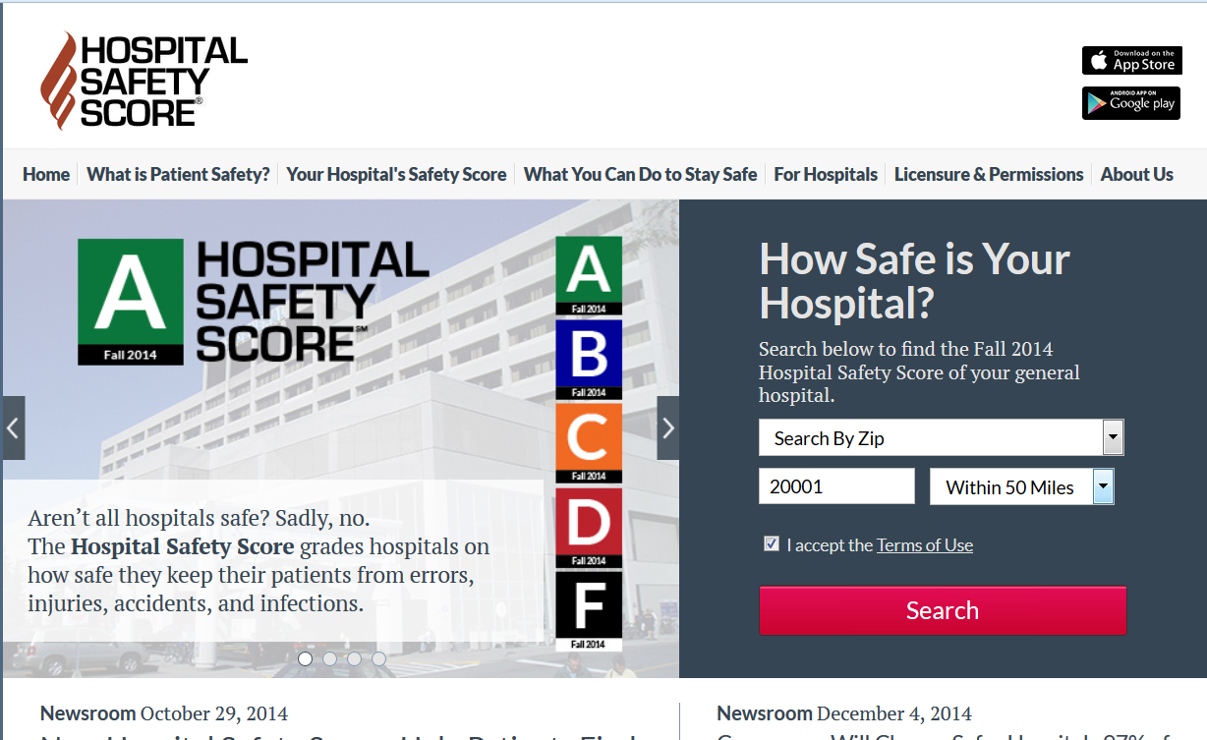
6
Notes:
You can search the site and drill down on any individual hospital to see how they compare nationally on any of the 28 measures used to calculate the score.

Slide 18

Also important to consumers…
Notes:
Hospitals that don’t report to Leapfrog have missing data, but the fact they didn’t report doesn’t count for or against them. We found in market testing that consumers react most strongly to “declined to report”—more troublesome to consumers than bad data on the hospital’s safety record. “What do they have to hide?” consumers in the market testing said. So we made sure and highlight when hospitals declined to report.

Slide 19
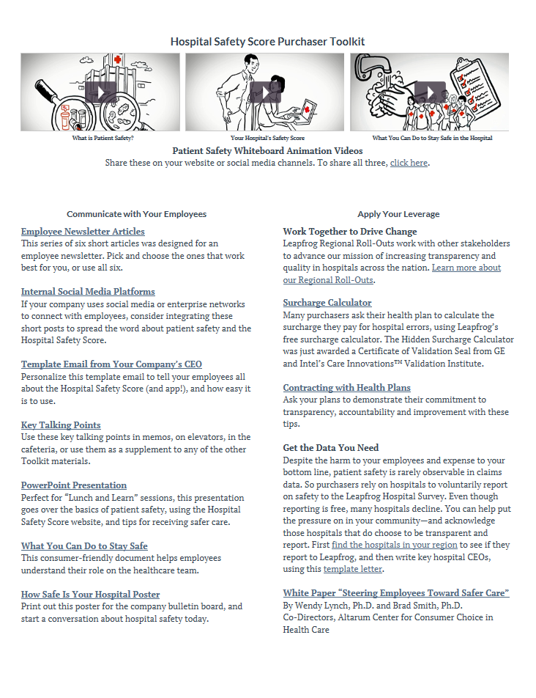
Purchaser Toolkit
Notes:
We also offer a toolkit for purchasers to use the Hospital Safety Score, including sample social media messages, information on accessing the data and downloading the free app, and tips for benefits programs in general. All of this is free and on the website.

Slide 20
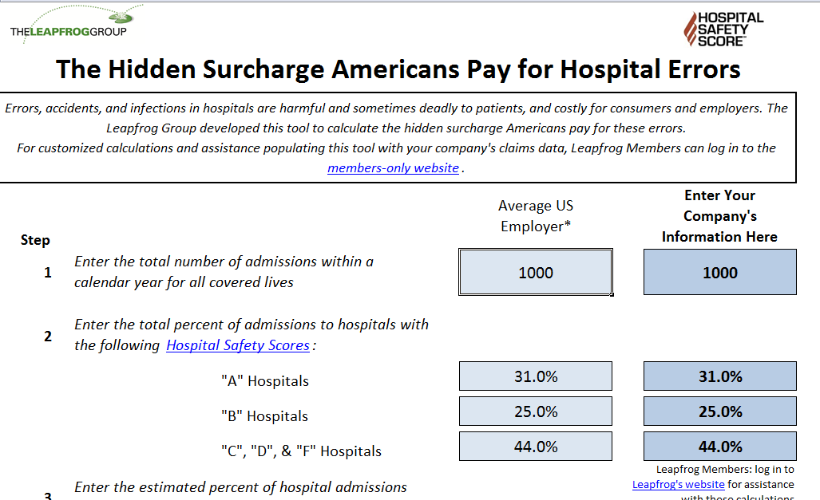

Calculating Waste
Notes:
Last year Leapfrog issued a free calculator purchasers can use to estimate the hidden surcharge they pay for errors, accidents, and injuries in hospitals. It is free and includes a downloadable spreadsheet. The methodology was validated by GE and Intel’s Care Innovations Validation program.

Slide 21
2016
Launch of on site Survey verification & quality improvement tools from DHG
New state of the art Survey platform and Leapfrog website
Review of surgery reporting: outcomes, volume, overuse
Business Roundtable engagement/initiatives
Actionable tools for value (for purchasers and hospitals)
Completed long range strategic plan, including consideration of rating/collecting data on:
  Outpatient surgery and ambulatory surgical centers
  Physicians
  Surgeons
  Health systems
  VA hospitals

Slide 22
Contacts/Resources
The Leapfrog Group (@LeapfrogGroup): www.LeapfrogGroup.org
Hospital Safety Score: www.HospitalSafetyScore.org
Leah Binder (@LeahBinder)
  Lbinder@LeapfrogGroup.org
  202-292-6713
www.forbes.com/sites/leahbinder/
www.huffingtonpost.com/leah-binder/
http://blogs.wsj.com/experts/tag/leah-binder/

